Slide 1
Acorn Class Meet the Team
Mrs E Calvert
Early Years Foundation Stage EYFS

Slide 2
Transition to School
Yes we have already met…
…it was lovely to have your child and yourself in school to have a family meeting with the Early Years staff prior to their first day with us. This allowed you to tell us about your child so that we can quickly start to work with you to support your child's learning.
A happy start to school is essential, our warm and caring approach ensures a successful beginning to being a life-long learner.

Slide 3
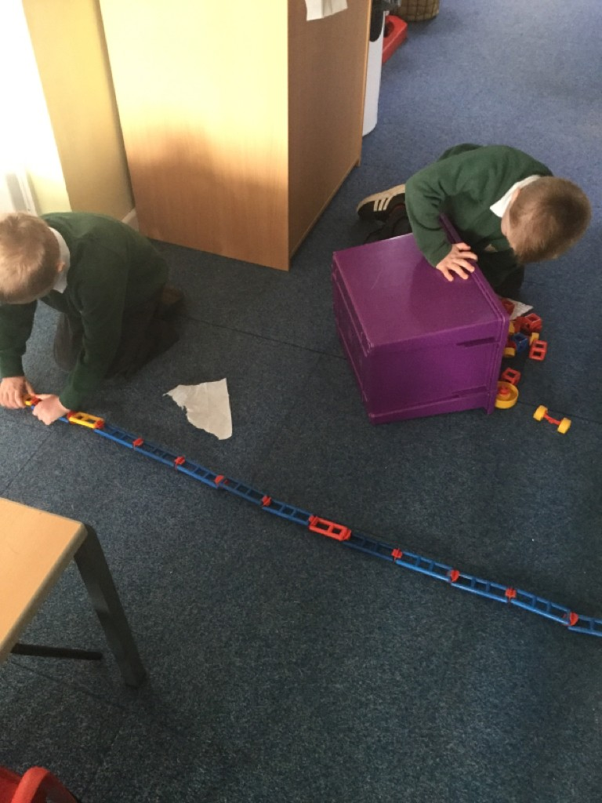
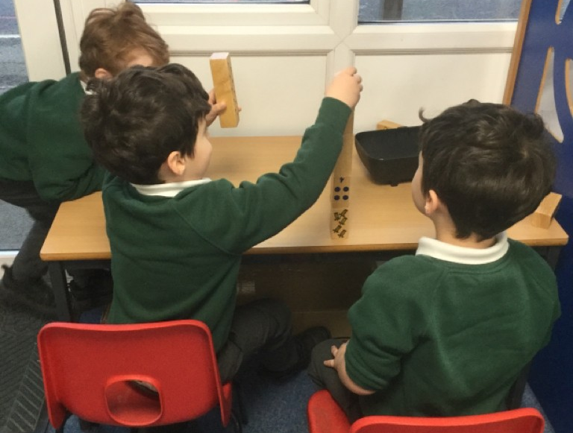
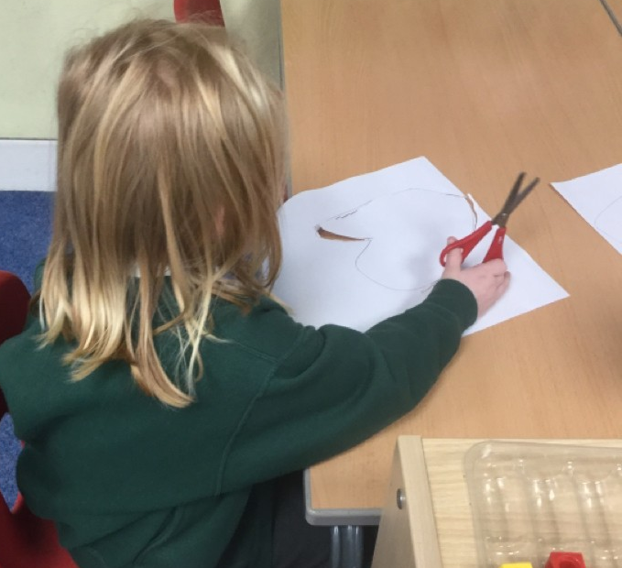
Characteristics of Effective Learning
Playing and Exploring
Active Learning
Critical Thinking
Do you see the three characteristics? Do you see them really engaged? Do you see them motivated? And do you see them doing their own thinking?
Notes:
Feedback from parents about induction.
What have we been up to?
Why parents are so important.
Supporting learning at home.

Slide 4
The Foundation Stage Curriculum
3 prime
areas of learning:
4 specific
areas of learning:
Communication and Language
Literacy
THE HOW
THE WHAT
Mathematics
Physical Development
Understanding of the World
Personal, Social and
Emotional Development
Expressive Arts
and Design
We collect evidence against these areas
Contributions from home are really important – please add to these to Tapestry
Notes:
‘Discovery Time’ – ‘bump into philosophy’
Evidence – observations, photos, 1:1 and group work, whole class
Verbal Feedback
Individual levels and attention span
Post-it activity – write down one thing your child has achieved at home recently. (Evidence for WOW books).
VIDEO

Slide 5
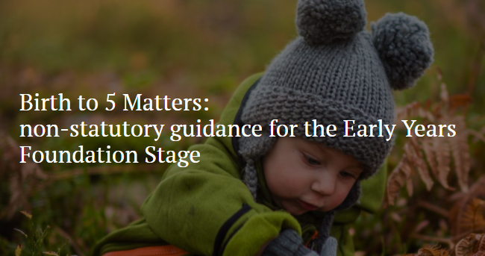
More information about Areas of Learning and Characteristics of Effective Learning can be found in these guidance materials:
https://www.gov.uk/government/publications/development-matters--2
https://birthto5matters.org.uk/
Notes:
Address on handout
Gives an insight into working in Early Years.

Slide 6
Influence on Learning
Not sure what to tell us? Just have a go and we will guide you. It might help to think about the Areas of Learning and the Characteristics of Effective Learning.
85% of children’s waking time is out of school. That’s why we love to hear about your learning at home via Tapestry.
Notes:
Consolidating learning
Reading – at home and ‘out and about’ - signs, menus etc.
Counting and recognising numbers
Counting money
Making up stories
World Around Us
EVIDENCE FOR WOW BOOKS
Nursery Rhymes

Slide 7
A little more about… Literacy (Reading & Writing)
There are lots of skills involved in learning to read and write:
Concepts about print e.g. reading and writing left to right etc
Reading Skills – storytelling, learning new
vocabulary, phonological awareness (rhyme,
syllables, recognising alliteration)
Phonics: blending phonemes (sounds) to read and
and segmenting phonemes to write.
We follow the Read, Write Inc scheme.
https://www.ruthmiskin.com/en/parents-copy-2/
Building confidence in word reading, fluency,
understanding and enjoyment
Handwriting – develop gross and fine
motor skills to enable correct letter
formation
You have already received your child’s My Sound Book with lots of guidance about Read, Write Inc and how we teach phonics including: Order of phonemes taught, Fred Talk, Word Time, Fred Fingers for spelling. More guidance will follow on Tapestry as your child progresses. But there are also useful videos to help parents – see link above.

Slide 8
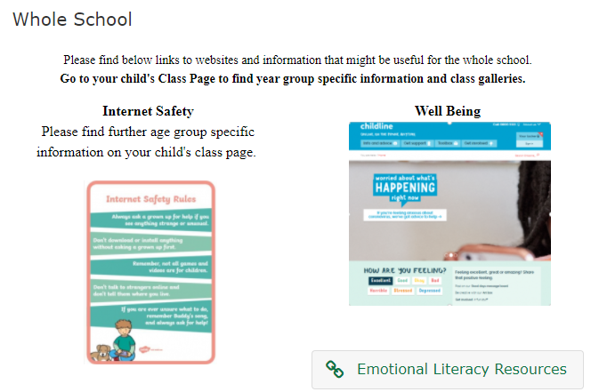
How will we communicate with you?
School Website and our Acorn Class webpage (found under the ‘Our School’ tab – ‘Class Pages’. Don’t forget to read the ‘Whole School’ information too.
The weekly newsletter: ‘Up to the Minute’
Termly Topic Web on the Website and 2-3 Weekly Planning on Tapestry.
We are really happy to answer quick queries at the classroom door but remember the children’s safety and settling into school is really important to us and we like to be in the class engaging with them.
Leave a message with the adult on the gate or email: messages@loxwoodschool.com. These messages always arrive promptly in the classroom.
Book an appointment or speak to us at the end of the day.

