Slide 1
Meet the Team

Slide 2
Welcome to Willow Class
2021-22

Slide 3
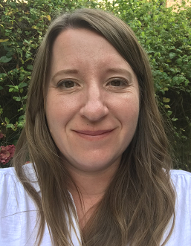
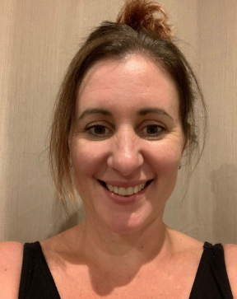
Willow Class Team
Hello I am Mrs Rolland, Willow Class’
teacher.
Mrs Hounsham is our Classroom Assistant.
Mrs Pinder will be teaching in class on a Tuesday morning to cover my Planning Preparation and Assessment time.
We are all really looking forward to working with you and your children this year.

Slide 4
Your child needs…
Named water bottle every day please that is extra to the one in their lunch box.
Named Wellies (we will be going on walks around the school grounds throughout the year).
Weather appropriate named coat every day.
Named clothing, especially jumpers and cardigans!
Full & named P.E Kit. (P.E days – Tuesday and Wednesday morning) Trainers are allowed and are often more supportive than plimsolls!

Slide 5
Year 2 Expectations
To begin with activities and learning will be more similar to Year 1, becoming more independent as the year goes on .
The children will be encouraged to become increasingly independent and organised, to enable them to be ready for KS2.
The children will continue to learn in different ways and will be given some choice in their learning and in how they challenge themselves.

Slide 6
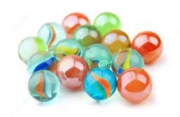
Rewarding ‘good’ choices
Children will be awarded house points for demonstrating our school values of perseverance, happiness and collaboration.
We collect marbles to earn our ‘Golden Time’ on a Friday. As a class we will be aiming to collect 20 Marbles in our jar a week to begin with. These are awarded for all children working as a team such as everyone helping to tidy up, sitting or lining up quietly or walking sensibly through the school. We use our maths skills to count the marbles and work out how many we still need to earn. We can even apply our knowledge of fractions!

Slide 7
Home Learning
Reading – as often as possible, 10 mins every day is desirable. We will remind children during the day to change their books but if in doubt send them in with their book ready to hand to the teacher in the morning.
Phonics/Spellings lists are on our Class Page and on Tapestry (and on this PowerPoint!) for you to work through at your own pace.
Home learning Grid tasks can be uploaded to Tapestry or sent in to share in class in person. We will look at these as soon as possible in class.

Slide 8
Reading
We recommend that you try to read with your child at least 3 times a week for approximately 10mins. We appreciate family life is busy, but any time you dedicate to practising reading skills will be beneficial to your child’s development.
We will remind children to change their ”Free Reader” book as they come into the classroom in the morning and at quiet reading time.
Your child will also have a “Phonic Reader” book to practise at home. This will be changed once a week by staff. This is to be kept in their plastic phonics folder in their book bag and bought to school each day as we will also be reading them in school.

Slide 9
Reading
This year we are going paperless and asking you to record your child’s reading progress at home using Tapestry! This doesn’t need to be every time that they read but as and when you feel you’d like to.
Feel free to upload videos of your child discussing books with you or photos of any reading related activities that they complete.
We will endeavour to ‘like’ or reply (if appropriate) as soon as possible to your comments.

Slide 10
Take a closer look at READING
We are sharing and talking about books daily and will be group and paired reading every week.
Remember that sharing an experience with words doesn’t have to be with a book!
Developing a love of reading is most important.
We focus on word reading and comprehension. Talking about a book is just as important as reading it!
Become a reading volunteer or recommend someone who can.
“Parental involvement in reading is a stronger influence on children’s achievement than factors such as family income, class and even parents’ education.” (Flouri and Buchanan, 2004)

Slide 11
Spelling in Year 2
In Year 2 we will be focusing on…
All phonics (letter sounds) learned since Reception.
Year 1 and 2 Common exception words
In addition to…
Beginnings(Prefixes)- un/in/bi/il/im
Endings(suffixes)- ly/ing/ed/est
Contractions- can’t/won’t
Possessive Apostrophes – Mrs Rolland’s pen…/ the girl’s book…
Words that sound the same (Homophomes)- son/sun bear/bare
TO NAME JUST A FEW….

Slide 12
Phonics in Year 2
In Year 2, all children practise their sounds as part of the curriculum.
We follow the Read Write Inc scheme as a school.
Year 2 are put into groups according to the sounds they already know, so children focus on the appropriate sounds for their current need. (These groups are not static and are open to change).
Last year, due to Covid, the Government did not require children to take their ‘Phonic Screen’ at the end of Year 1, as is normally the case. However, we are constantly assessing their phonic progress within school so that we know how best to help and support each child.
It is likely that the children will be required to take a ‘Phonic Screen’ assessment in the Autumn Term in Year 2. This is undergone with their class teacher and takes about 10 minutes 1-1 per child. Children are required to segment and blend words and non-words containing the phonemes that they have already been taught in school. This is something that is familiar to the children already.

Slide 13
Phonics in Year 2

Slide 14
Spelling in Year 2
Please focus on reading and spelling these Common Exception Words at home at your own pace throughout the year.

Slide 15
KS1 SATs
The Key Stage 1 SATs officially assess your child’s Maths and English abilities. Although they include formal tests, they are done in a relaxed way; in fact most children are not even aware they’re taking a test! The tests are used as a tool for teacher assessment.
They consist of two reading tests (long and short), two Maths tests (arithmetic, mental reasoning), English grammar, punctuation and spelling (optional)
You may find this website helpful https://www.theschoolrun.com/ks1-sats-questions-answered

Slide 16
Example SATs questions
Example SATs Question from KS1 Sample Test. 2016. English Grammar, Punctuation & Spelling

Slide 17
“Poppy held the rabbit gently in her arms”
Example SATs questions
What type of word is underlined in the sentence?
Adjective
Noun
Adverb
Verb
Example SATs Question from KS1 Sample Test. 2016. English Grammar, Punctuation & Spelling.

Slide 18
Keeping Up-to-Date
Remember to check…
Tapestry
The school website and the Up to the Minute
Willow Class Webpage – You will find our Termly Topic Web and Home Learning Grid
Book bags – check for letters and forms to complete

Slide 19
Important dates for this term Parents Eve
Tuesday 12th October and Thursday 14th October.
2.10pm-4.10pm-face to face meetings.
4.10pm-5pm-virtual meetings only.

Slide 20
Any questions? If you have any questions, please ask at school drop off or pick up. You can also email us at messages@loxwoodschool.com, addressing the emails to Mrs Rolland.

