Slide 1
‘Meet the Team’
Mulberry Class
Year 5
2018-2019

Slide 2
The Team
Resilience
Teamwork
Independence
Happiness
Class Teacher – Mrs Winter, Miss Durkin
Teaching Assistant – Mrs Pinder & Mrs Olliver

Slide 3
Homework
Homework needs to be: meaningful, manageable, have a positive impact on learning and be enjoyable.
Research shows that most homework has no effect on learning at this age.
So as was the case last year, this year all children will be given a clearly structured format to help with spelling.
In addition we will assume that you are monitoring your child’s reading which needs to be regular! Reading Record books are not issued now unless we particularly want to keep a close check on a particular child. However you can always request one if you would find it helpful.
Times tables should also be a constant in their lives. They will have a timed challenge every Tuesday morning.
Each term they will receive a grid of activities. They will choose 2 tasks per half term. Any tasks brought in will be celebrated but there will be no punishment for tasks not done – eg they will not be kept in at playtime to carry out these tasks. We would love you to feel part of these activities which are designed to appeal to different strengths and learning styles.

Slide 4
Reading
“Parental involvement in reading is a stronger influence on children’s achievement than factors such as family income, class and even parents’ education.” (Flouri abd Buchanan, 2004)
What do we actually mean by reading?
Reading for pleasure
Choose a book that is not so difficult that the meaning is lost in the struggle to decode.
Word reading / comprehension (both listening and reading)
Bedtime stories, audio books, siblings
Questioning
Our assessment of reading
Parent Helpers

Slide 5
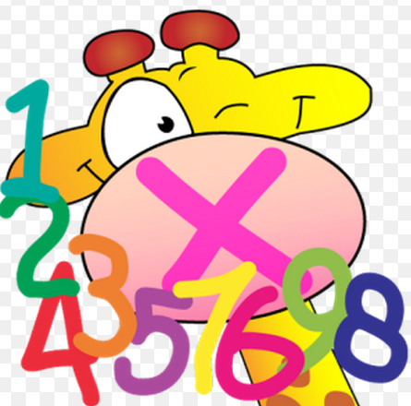
Times tables
All times tables up to 12 x 12
Games / apps
http://www.topmarks.co.uk/maths-games/7-11-years/times-tables
http://resources.woodlands-junior.kent.sch.uk/maths/timestable/
http://www.teachingtables.co.uk/
TT Rock stars and SumDog. We will reissue their logins if necessary but all
children are already registered with both of these websites.

Slide 6
Assessment
Formative - in our classrooms every day and includes sharing criteria with the children, and giving them feedback while they are working towards those goals. The purpose is to help students understand how to improve and also to inform teachers planning. The children are becoming adept at analysing their own work critically and are self-editing with their green pens. They also now identify their own next steps.
Summative - typically occurs at the end of a learning sequence, course or unit to establish levels of achievement for reporting. We may use the more familiar “test” to identify gaps in learning.

Slide 7
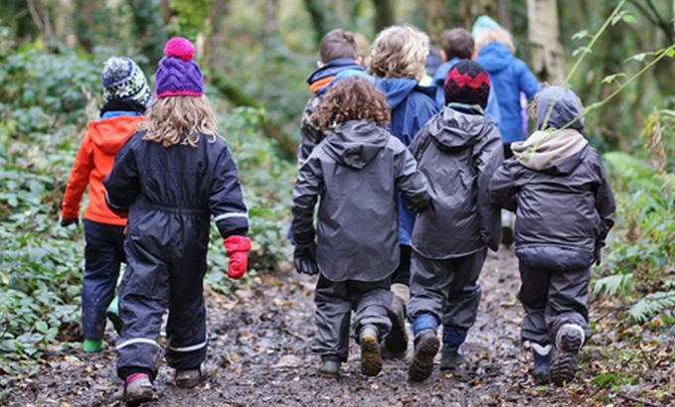
P.E.
Wednesday pm. – Games with external coach (but the time changes from term to term)
Friday am – Cricket with a specialist coach this term
P.E. kit and trainers in school at all times (named)
Earrings removed or taped
Forest School
Wednesday afternoons (dates tbc). For Year 5 not this
half term as we are on our Residential
Snacks
If your child would like to have a snack in the morning please only send a piece of fruit or vegetable. Water only to drink.

Slide 8
Computing
School website
Communication – twice a half term
Topic Web
Homework Grid
e-Safety
The children receive information on safe use of the internet during curriculum time.

Slide 9
Residential Trip
Sayers Croft
8th October – 10th October 2018
Paperwork and information meeting 3:15 27th September

Slide 10
Questions?

